Slide 1
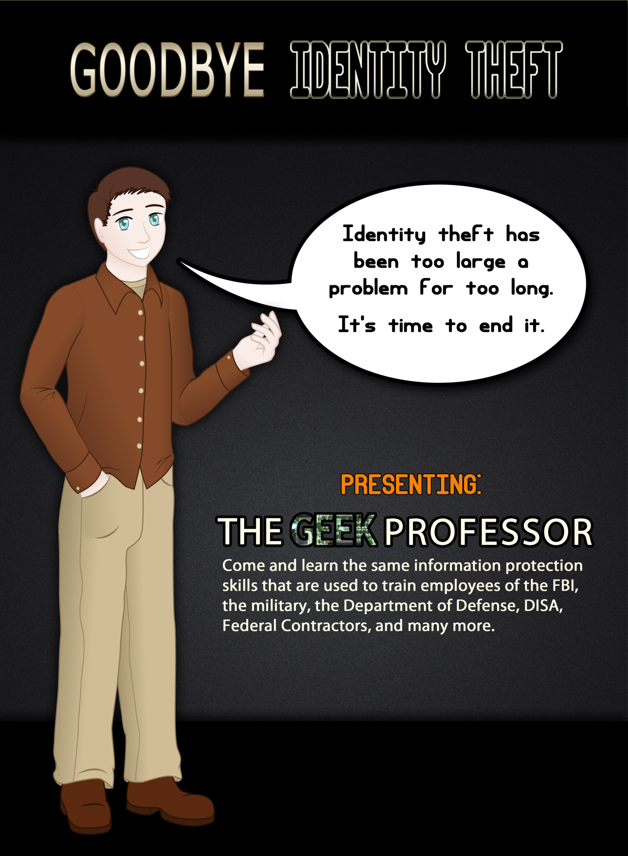
Saturday, Oct 9th
Falls Hills Church
Annex B Auditorum
7:00p to 8:00p

Slide 2
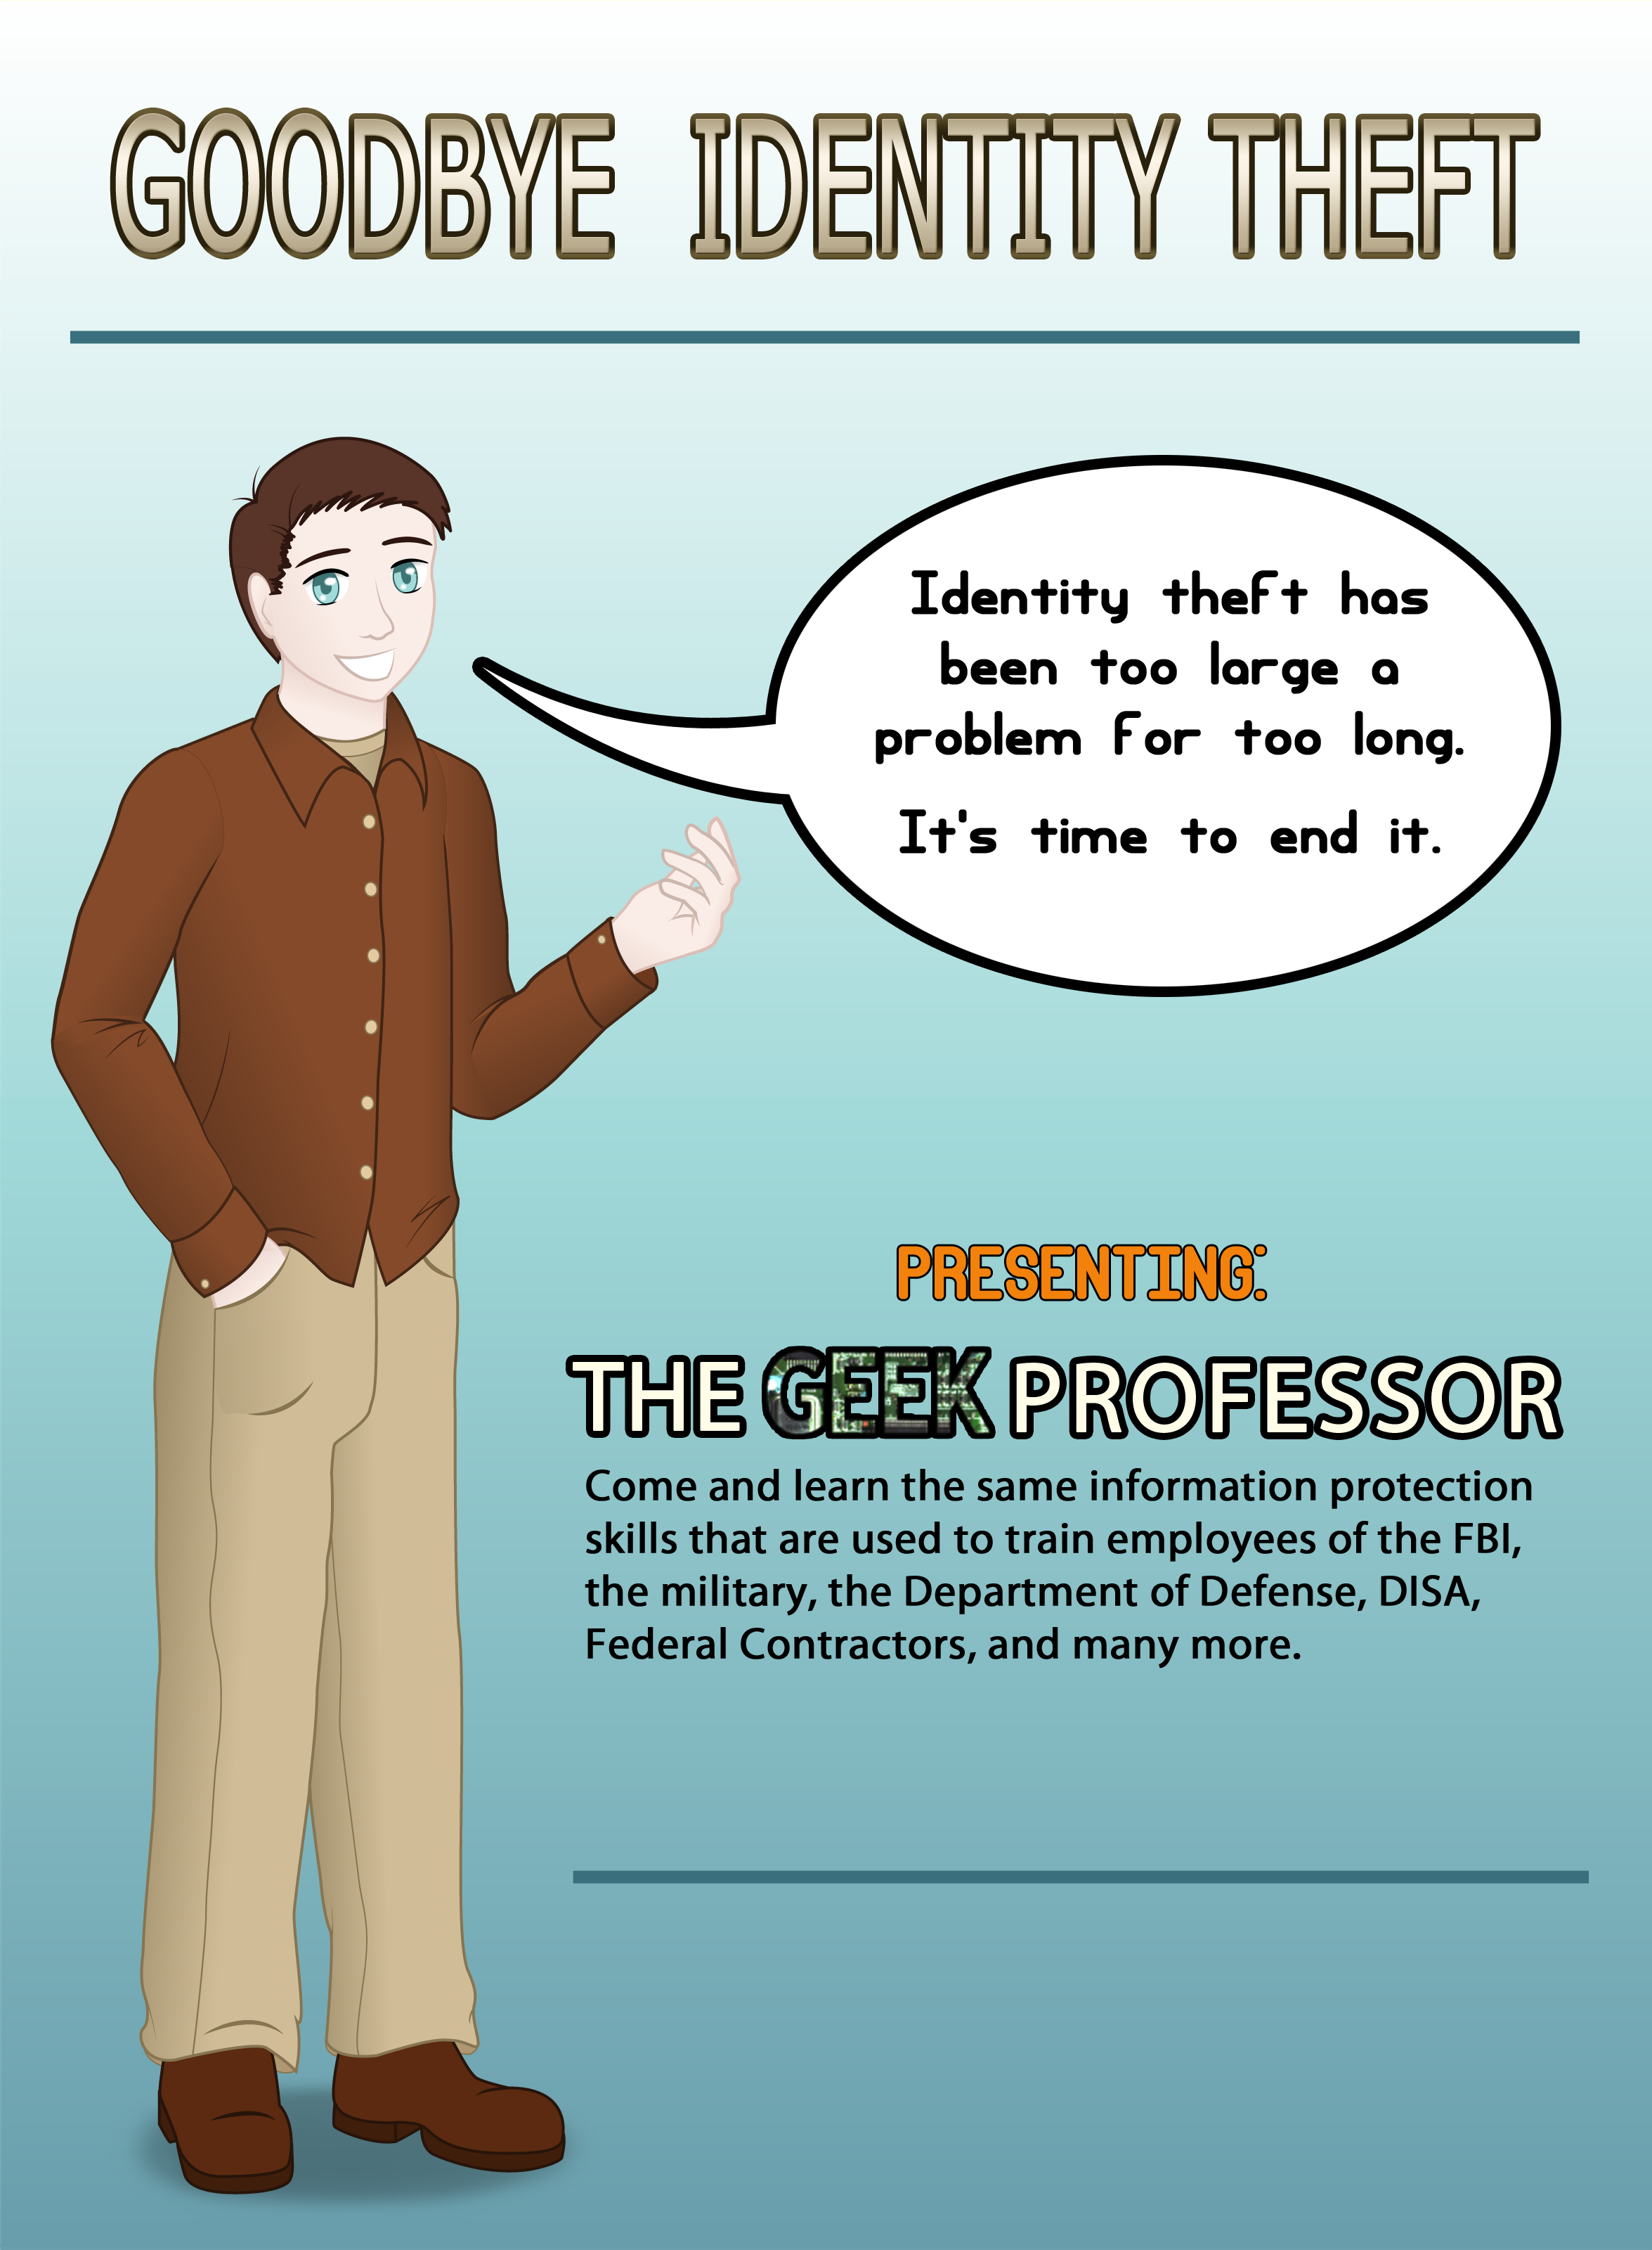
Saturday, Oct 9th
Falls Hills Church
Annex B Auditorum
7:00p to 8:00p

